Slide 1
DATA MANAGEMENT FRAMEWORK Data Management covers Data Governance

Slide 2
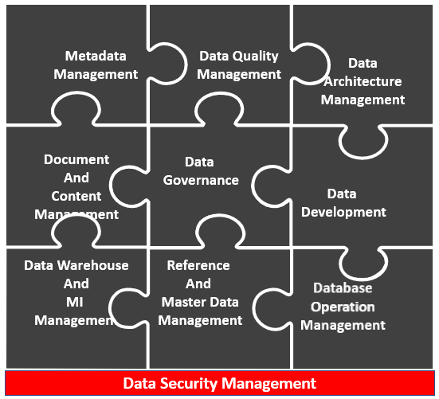
DATA MANAGEMENT FRAMEWORK
In a Data management Framework, Data Governance sits at center of closely interrelated functions. Establishing a Data Governance is a pre-requisite of successful delivery of all other functions.
Data Governance – Planning, Supervision and Control over Data management and Data Usage
Data Quality Management – Defining, monitoring, and improving Data quality
Data Architecture Management – Integral part of Enterprise architecture Framework
Data Development – Analysis, Design, Building, Testing, Deployment and Maintenance
Data Operation Management – Providing support for structured physical data assets
Reference and Master Data Management – Managing golden version and replicas
Datawarehouse, Data Lakes and Management Information Management – Providing utilities for decision support, business enablers, statistics, and analysis of data
Document and Content Management – Storing protecting and & indexing unstructured data
Metadata Management – Integrating, controlling, and delivering Metadata
Metadata
Management
Data Quality
Management
Data
Architecture
Management
Document
And
Content
Management
Data
Governance
Data
Development
Data Warehouse
And
MI
Management
Reference
And
Master Data
Management
Database
Operation
Management
Data Security Management

Slide 3
DATA MANAGEMENT FRAMEWORK – GOALS AND PRINCIPLES
DMF Goals
To understand information needs of enterprise and stakeholders
To capture, store, protect and ensure the integrity of data assets
To continually improve quality of data and information
DMF Principles (Examples)
Information and Data management will be a Business function and set of related desiplines
Information is a Business asset and it will be organized and managed to maximise enterprise value
To ensure privacy and confidentiality, and to prevent unauthorized or inappropriate use of data
To maximise effective value and use of data and information assets
To control the cost of data management
To promote wider and deeper understanding of data assets
To manage information consistently across enterprise
To align data management and governance efforts with Technology and Business needs
Information will be readily available supporting a clear Business need, to all authorized staff and relevant external entities
All enterprise information will be owned by Nationalgrid
All information will have data stewards who are accountable for its consistency, availability and accessibility
Data is required by users in order to perform their functions and data needs to be available in timely manner

Slide 4
DATA MANAGEMENT FRAMEWORK – FUNCTION
Business strategy
Business Activity
IT Activity
Data Issues
Data Governance
Data Architecture Management
Data Operations Management
Data Security Management
Reference & Master Data Management
Datawarehouse, Big Data, Datalake Management
Document & Content Management
Metadata Management
Data Quality Management
Improved Data quality
Data strategy
Data Architecture
Data services
Databases
INPUTS
PRIMARY DELIVERABLES
Executives
Data Creators
External sources
Regulatory Bodies
Operations staff
Managers
Executives
Customers
Regulatory bodies
SUPPLIERS
ACTIVITIES
CONSUMERS
Data Creators
Information consumers
Data Stewards
Data Professionals
Executives
Data Modelling Tools
Database Management systems
Data Integration and Quality Tools
Business Intelligence Tools
Document Management Tools
Metadata Repository Tools
Data Value metrics
Data quality metrics
Data program metrics
PARTICIPANTS
TOOLSETS
METRICS

Slide 5
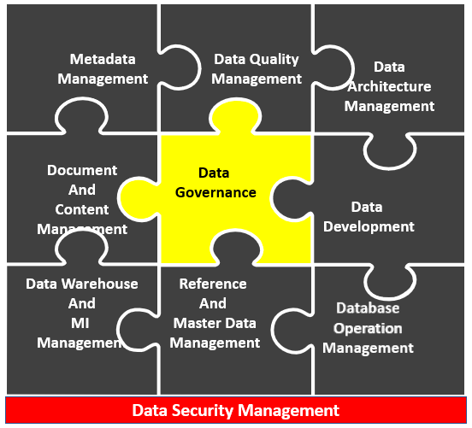
DATA GOVERNANCE – GOALS AND PRINCIPLES
Data Governance Goals
To define, approve and communicate data strategies, policies , standards, architecture, procedures and metrics
Data Governance Principles (Examples)
Ownership will be established for data and information within Nationalgrid
To track and enforce regulatory compliance and conformance of data to data policies, standards, architecture and procedures
To sponsor, track and oversee the delivery of data management products and services
To manage data related issues
To understand and promote the value of data assets
COE for Information management will be owner of underlying conformed dimensions
Business community will be owners of metrics and KPI’s

Slide 6
DATA GOVERNANCE – FUNCTIONS
Business goals
Business & IT strategies
IT Objectives
Data needs
Data Issues
Regulatory requirements
Data Management Planning
Understand strategic enterprise data needs
Establish data professional roles
Identify and appoint data stewards
Establish COE to support data governance and stewards
Develop and approve data policies, standards and procedures
Review and approve data architecture
Plan and sponsor Data mgmt. projects
Estimate data asset values and costs
Data Management Controls
Supervise data professionals activities
Coordinate Data governance activities
Manage and resolve data related issues
Monitor and ensure regulatory compliance
Monitor and enforce data conformance
Oversee data management projects and services
Communicate and promote value of data assets
Data policies
Data standards
Issue resolution metrics
Data management projects and services
Data quality metrics
Data value metrics
INPUTS
PRIMARY DELIVERABLES
Business executives
IT executives
Data stewards
Regulatory bodies
Data producers
Knowledge workers
Managers and executives
Data professionals
Customers
SUPPLIERS
ACTIVITIES
CONSUMERS
Executive data stewards
Business data stewards
Data professionals
Data management executives
CIO
Internet websites
Emails and other communication channels
Metadata tools
Issues management tools
Data governance KPI dashboards
Data Value metrics
Data management costs
Number of decisions made
Stewardship representation and coverage
Data management process maturity
PARTICIPANTS
TOOLSETS
METRICS

Slide 7
DATA GOVERNANCE ORGANIZATION - ILLUSTRATION
Procedures
Policies
Roles
Responsibilities
MANDATA & AUTHORIZE
Executive
Management
EXECUTIVE COUNCIL
Corporate
Ownership
&
Regulatory Responsibility
Data Governance
Council
Business & tech
Domain stewards
ADVISORS
AUTHORITY & ACCOUNTABILITY
DATA GOVERNANCE COUNCIL
Business Domain Stewards
Data Management Organization (DMO)
CONSULTANT
Technical Domain Stewards
Tools Arch.
Data Models
Metadata Repository
Business Analysis
Information
Ownership
&
Operational Responsibility
DATA STEWARDSHIP & EXECUTION
Business Stewards
LINE OF BUSINESS GOVERNANCE
Logical Data Stewards
Physical Data Stewards

Slide 8
DATA GOVERNANCE ORGANIZATION – ROLES AND RESPONSIBILITIES
 | ROLES | RESPONSIBILITY
GOVERNANCE COUNCILS | EXECUTIVE SPONSOR | Strategic oversight of Data programs and related Data Issues
 | BUSINESS UNIT MANAGERS | Provide subject matter advise on Data usage and definitions. Resolve issues raised by Data quality analysts
 | SOURCE SYSTEM MANAGERS | Owners of legacy system-specific issue resolution. Provisions systems Subject Matter experts on issue remediation
STEWARDS | SUBJECT AREA STEWARDS | Provides Ownership of Data across all processes and functions. Helps to resolve Data issues, signs off requirements and specifications
DATA QUALITY WORKING GROUP | DATA QUALITY MANAGERS | Management issue escalation to Business executives and source system owners. Has an oversight on execution of Data quality testing and reporting
 | BUSINESS ANALYSTS | Defines Standards, Business rules and Business process definitions
 | TECHNICAL ANALYSTS | Performs source data collaboration, Data Modelling collaboration and Physical design collaboration
 | DATA QUALITY ANALYSTS | Compliance auditing – Data standards, Business rules, Data management processes, Issue Management, Profile and measure Data values

Slide 9
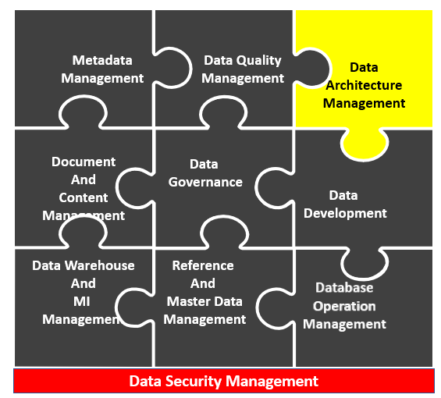
DATA ARCHITECTURE MANAGEMENT – GOALS AND PRINCIPLES
Data Architecture Goals
Plan with vision and foresignht to provide high quality data
Data Architecture Principles (Examples)
Solutions will be designed in an information centric manner
To identify and determinie common data requirements
To design conceptual structures and plan to meet current & long term data requirements to the enterprise
Data entered into one system will not be “re-keyed” into another system manually
Transactional data will never change in IT landscape
All data that that needs to be moved benween systems will refer to canonical data models
Data Integration events wil be triggered by Business process evnts

Slide 10
DATA ARCHITECTURE MANAGEMENT – FUNCTIONS
Business goals
Business & IT strategies
Business architecture
Process Architecture
IT Objectives
Data strategies, Data Issues & Needs
Data Management Planning
Understand enterprise information needs
Develop and maintain enterprise data model
Analyze and align with other Business models
Define and maintain data technology architecture
Define and maintain data integration architecture
Define and maintain Datawarehouse, Datalake and Business Intelligence architecture
Define and maintain enterprise data taxonomies
Define and maintain metadata architecture
Enterprise data models
Information Value chain analysis
Data Technology architecture
Data Integration and MDM architecture
Datawarehouse, Datalake and Business Intelligence architecture
Metadata architecture
Enterprise taxonomies
Document management architecture
Metadata
INPUTS
Business executives
Data stewards
Data Producers
Information consumers
PRIMARY DELIVERABLES
Data stewards
Data architects
Data analysts
Database administrators
Software developers
Project managers
Data producers
Managers and executives
SUPPLIERS
ACTIVITIES
Data Stewards and SME’s
Enterprise Data architects
Data analysts and modelers
Data Management execs & Managers
CIO and other execs
Database administrators
Data modelling administrators
Data modelling tools
Metadata repository
Information management tools
PARTICIPANTS
TOOLSETS
CONSUMERS

Slide 11
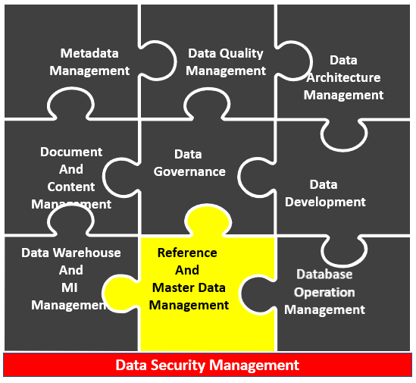
DATA – REFERENCE & MASTER DATA MANAGEMENT – GOALS AND PRINCIPLES
MDM Goals
Provide authoritative source of reconciled and high quality master data
MDM (Examples)
A single version of truth will exist for all data in IT landscape
Lower cost and lower complexity through reuse and leverage of standards
Support Business intelligence and information integration efforts
The single system of reference (SOR) will be official source of data sets for all subsequent inetration and dessimatetion
Book of Record (BOR) of data sets will be the systems where 80% of the process that maintain data are supported
Data will be entered and maintained in the nominated Book of Records (BOR)
Changes in global data will be synchronized across system landscape

Slide 12
DATA – REFERENCE & MASTER DATA MANAGEMENT – FUNCTIONS
Business drivers
Data requirements
Policies and regulations
Standards
Master & Transactional data
Data Management Planning
Understand reference and Master data management needs
Identify reference and Master data sources and contributors
Define and maintain data integration architecture
Implement reference and Master data management solutions
Define and maintain match rules
Establish “Golden records”
Define and maintain hierarchies
Plan and implement integration of new data sources
Replicate and distribute - reference & master data
Manage changes to reference and Master data
Master / Reference data requirements
Data models and documentation
Reliable Master / Reference data
Reliable Master / reference Data
“Golden record” data lineage
Data quality metrics and reports
Data cleansing activities
INPUTS
PRIMARY DELIVERABLES
Steering committees
Business data stewards
Subject matter experts
Data consumers
Standards organizations
Data providers
Application users
BI and Reporting users
Application developers/architects
Data integration developers and architects
BI developers and architects
Vendors, Customers and Partners
SUPPLIERS
ACTIVITIES
CONSUMERS
Data Stewards and SME’s
Enterprise Data architects
Data analysts and modelers
Application architects
Data governance councils
Data providers
Reference and MDM applications
Data and process modelling tools
Metadata repositories
Data profiling and cleansing tools
Data Integration tools
Business processes and rules engines
Change management tools
Reference and Master data duality
Data change activity metrics
Data issues / Cost / Volume stats
Data Use and Re-Use statistics
Data availability statistics
Coverage of Data by Data stewards
PARTICIPANTS
TOOLSETS
METRICS

Slide 13
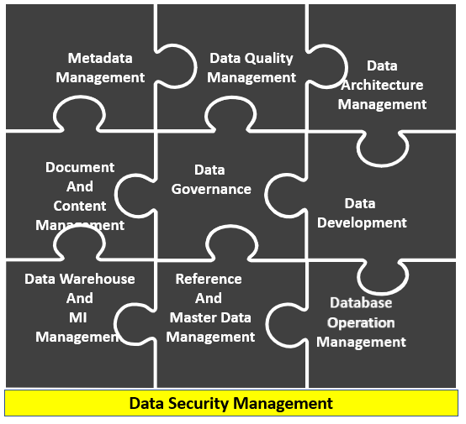
DATA SECURITY MANAGEMENT – GOALS AND PRINCIPLES
Data Security Goals
Data Security Principles (Examples)
Data and Information will have same level of security and any other valuable asset within Nationalgrid
Enable appropriate and prevent inappropriate , access and changes to data assets
Meet regulatory requirements for privacy and Confidentiality
Ensure privacy and confidentiality is the need for all stakeholders

Slide 14
DATA SECURITY MANAGEMENT – FUNCTIONS
Business Goals and strategy
Business rules and processes
Data strategy
Data privacy issues
IT policies and standards
Data Management Planning
Understand Data security needs and regulatory requirements
Define data security policies
Define data security standards
Define Data security controls and procedures
Manage IAM and Access controls
Manage Data access views and permissions
Monitor user authentications and behaviors
Classify information confidentiality
Audit Data security
Data security policies
Data privacy and confidentiality standards
User profiles, passwords and memberships
Data security – Permissions and controls
Data access views
Data and Document classifications
Authentication and access history
INPUTS
Data stewards
IT steering committees
Data governance council
Customers, Internal & external stakeholders
PRIMARY DELIVERABLES
SUPPLIERS
ACTIVITIES
Data Stewards and SME’s
Data security administrators
Database administrators
Data architects
Data management leaders
CIO / CTO / CSO’s
Database Management systems
Business Intelligence tools
Application frameworks
Identity and access management tools
Change control systems
Data producers
Managers and Executives
Customers
Data professionals
PARTICIPANTS
TOOLSETS
CONSUMERS

Slide 15
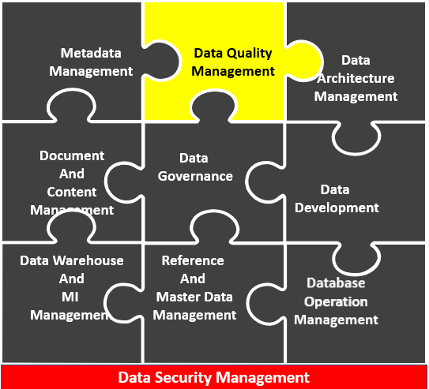
DATA QUALITY MANAGEMENT – GOALS AND PRINCIPLES
Data Quality Goals
To measurably improve the quality of data in relation to defined Business expectations
Data Quality Principles (Examples)
To define requirements and specifications for integrating data quality control into system development lifecycle
To provide defined process for measuring, monitoring and reporting conformance to acceptable levels of data quality
Data will be maintained and disseminated with necessary enterprise wide controls so that integrity is preserved
Data will be fit for purpose
Data quality contracts will exist between producers and consumers of data
Data quality rules will be mastered within the organization
Data quality will be aligned with Business rules
Data quality checks and cleansing will occur in system of records
Downstream data consumers will specify data quality expectations

Slide 16
DATA QUALITY MANAGEMENT – FUNCTIONS
Business requirements
Data requirements
Data quality expectations
Data policies and standards
Business and Technical metadata
Data sources and Data stores
Data Management Planning
Develop and promote awareness
Define data quality requirements
Profile / Analyse / Assess Data quality
Define Data quality metrics
Test and validate Data quality requirements
Set and evaluate Data quality service levels
Continually measure and Monitor Data quality
Manage Data quality issues
Clean and correct defects related to data quality
Design and implement operational data quality management procedures
Monitor operational Data quality management procedures and performance
Improved Data quality
Data Management operational analysis
Data profiles
Data quality certification reports
Data quality service level agreements
INPUTS
PRIMARY DELIVERABLES
External suppliers
Business SMEs
Information consumers
Data producers
Data architects
Data modelers
Data stewards
Data Stewards
Data professionals
Other IT Professionals
Managers and execs
Customers and external agencies
Regulatory bodies
SUPPLIERS
ACTIVITIES
CONSUMERS
Data quality analysts
Data analysts
Database administrators
Data professionals
Data requirement management SME’s
Data stewardship council
Data profiling tools
Statistical analytical tools
Data cleansing Tools
Data Integration Tools
Issues & Event Management Tools
Data and Value statistics
Errors and Requirements violations
Conformance to expectations
Conformance to service levels
PARTICIPANTS
TOOLSETS
METRICS

